Slide 1
Dimension Modeling

Slide 2
Measures

Slide 3
A measure represents a column that contains quantifiable data, usually numeric, that can be aggregated.
Examples →
Salary from Employee Table
Discount from Customer Table
Hour_Rate from Consultants Table
Cost_Price, Selling_Price from Transactions Table, etc.

Slide 4
Fact Table

Slide 5
Fact Tables
A fact table stores variable numerical values related to aspects of a business.
For example, sales, revenue, budget. These are usually the values you want to obtain when you carry out a decision support investigation.
Mostly summarized values are derived from the fact tables’ data.

Slide 6
Fact table & Measure relationship
The values within the fact tables are called as measures.

Slide 7
Attributes
Attributes means columns of the main table.

Slide 8
Dimensions
Dimension will be equivalent to TABLE name (s) of the database.
One Dimension will have one or multiple attributes.
Those attributes could from one table or from multiple tables and view (s) of the database of OLTP / RDBMS..
Example → Product Dimension has attributes like product name, product category, etc.

Slide 9
Dimension and Attributes
Every Dimension MUST have at least one Key attribute.
Every Dimension will also have non key attributes
***Dimension table can also have Attribute Hierarchies.***

Slide 10
A Concept Hierarchy
Concept hierarchies allow data to be handled at varying levels of abstraction
Region
Dimensions: Product, Location, Time
Hierarchical summarization paths
Industry Region Year
Category Country Quarter
Product City Month Week
Office Day
Product
Month

Slide 11
Dimension - Hierarchy
Within a dimension, attributes are organized in a hierarchy.
Relating attributes into hierarchies provides the users with a high-level view across a few critical attributes.
Allows the users to drill down into each of the hierarchies to view more attributes.

Slide 12
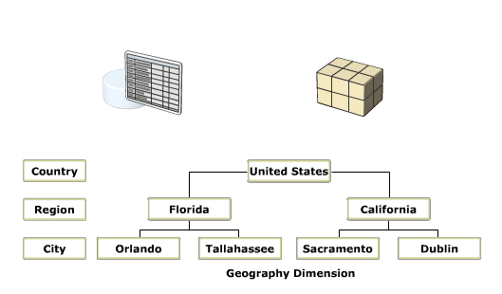
Establishing Hierarchy

Slide 13
Dimension Hierarchies
Store Dimension
Product Dimension
Total
Total
Region
Manufacturer
District
Brand
Stores
Products
Notes:
1
The simple model we will use to demonstrate the various design alternatives is composed of three dimensions. Only two are shown, Store and Product. The third, Time, is composed of the following attribute hierarchy: date -> month -> quarter -> year.
The Store dimension has an attribute hierarchy of store -> district -> region. Products is composed of products -> brand -> manufacturer.
Based on this simple model, we can see that the granularity of data is products sold in stores by day.

Slide 14
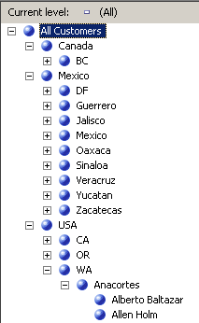
User Defined Hierarchies
User Defined Hierarchies are created from Attributes
Tree-like structure
City → State → Country → All
Provide navigation paths in a cube
Notes:
14

Slide 15
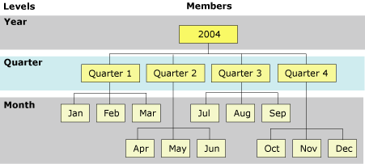
Typical Example – Calendar Hierarchy
The Year, Quarter, and Month attributes are used to construct a hierarchy, named Calendar, in the time dim.
The relationship between the levels and members of the Calendar dimension (a regular dimension) is shown in the following diagram.

Slide 16
Relation in Dimension & Fact Tables
Dimension tables are connected to a central fact table.
The primary key of the dimension table migrates as a foreign key in the fact table.

Slide 17
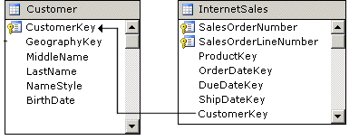
Regular Dimension Relationships
The Primary Key in the dimension table joins directly to Foreign Key in the fact table.
Notes:
A regular dimension relationship between a cube dimension and a measure group exists when the key column for the dimension is joined directly to the fact table. This direct relationship is based on a primary key–foreign key relationship in the underlying relational database, but might also be based on a logical relationship that is defined in the data source view. A regular dimension relationship represents the relationship between dimension tables and a fact table in a traditional star schema design.

Slide 18
Dimension Vs Fact Tables
Size of Dimension Table is smaller than Fact Table.
But number of Dimension table are more are than Fact Tables.
Values of fields can be in numeric but are mostly in text and date data types in case of Dimension tables
But, values of the fields are always in numeric or integer form in case of Fact tables

